Slide 1
Group 3
Electric Vehicle Population Data Analysis

Slide 2
Intro
Electric Vehicle Population Data Analysis
[Washington US]
Objective: To Analyze EV growth and distribution in Washington, US.
This dataset shows the Battery Electric Vehicles (BEVs) and Plug-in Hybrid Electric Vehicles (PHEVs) that are currently registered through the Washington State Department of Licensing (DOL) as of February 28, 2023.
Source : Kaggle
Tool : Jupyter Notebook

Slide 3
Methodology
Collecting Data
Procurement or creation of Dataset for given problem. This dataset was procured from Kaggle as a raw dataset.
Data Analysis
Analyzing the data using Python libraries such as Numpy, Pandas and Matplotlib to be visualized into graphs.
1
2
3
Data Cleaning
Cleaning the data and preparing it to be taken into Analysis and visualization by making appropriate changes.

Slide 4
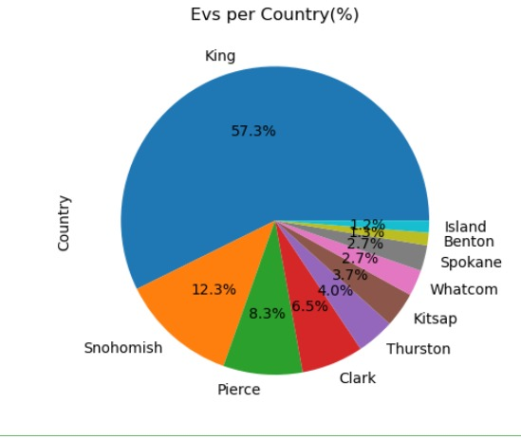
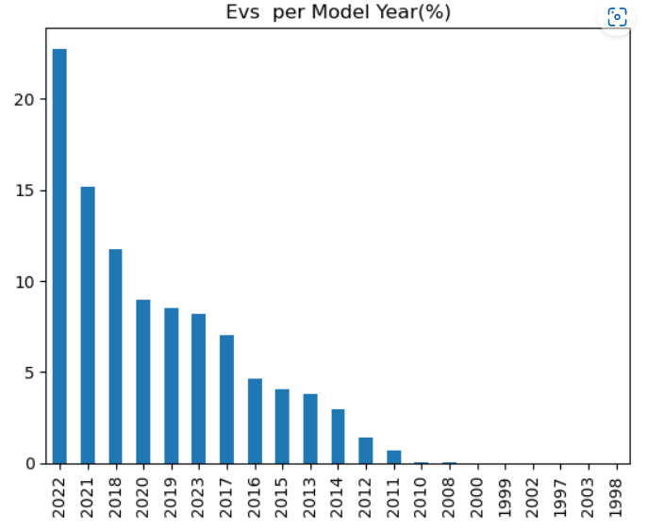
Analysis

Slide 5
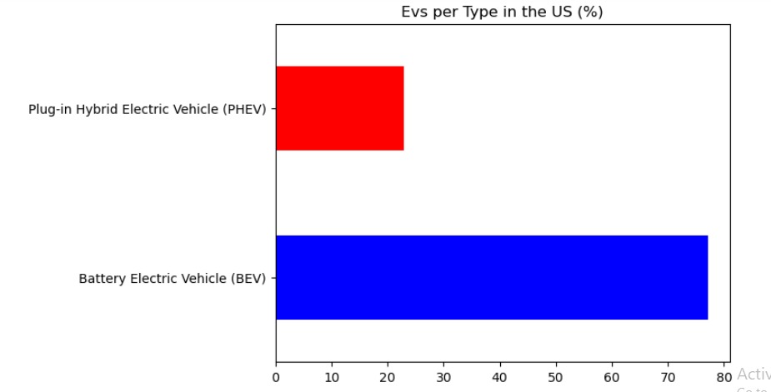
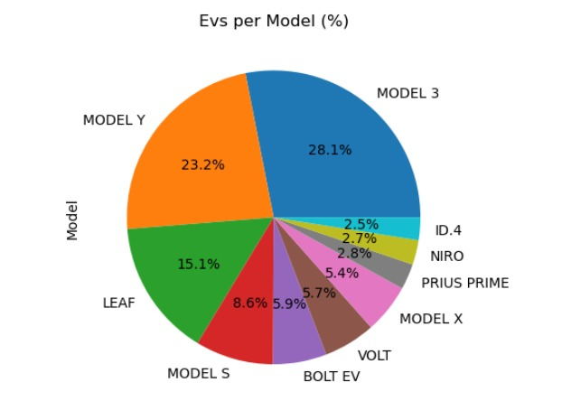
Analysis

Slide 6
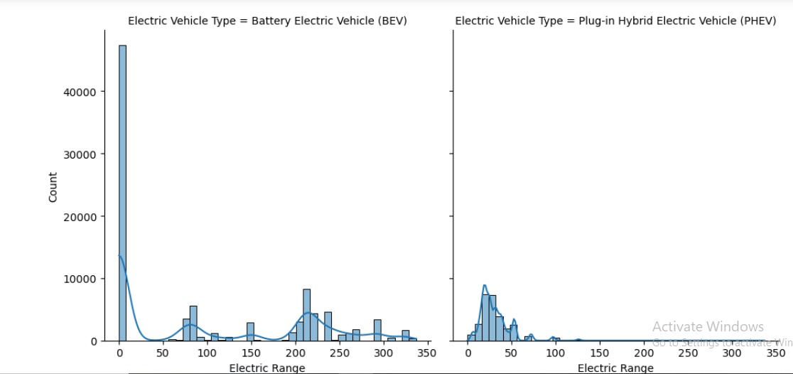
Analysis
**Electric Range is no longer maintained for Battery Electric Vehicles (BEV) because new BEVs have an electric range of 30 miles or more. Zero (0) will be entered where the electric range has not been researched.

Slide 7



Machine Learning Implementation
We used Linear Regression Model to find out the accuracy of sales data prediction

Slide 8

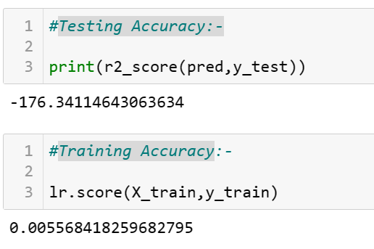
Getting The Accuracy
Here we are applying :-
1-Mean squared Error
2-Testing Accuracy
3-Training Accuracy

Slide 9
Conclusion
TESLA | 56116
NISSAN | 12938
CHEVROLET | 10775
FORD | 6571
BMW | 5350
KIA | 4763
TOYOTA | 4527
VOLKSWAGEN | 3171
More than 70,000 vehicles belong to the Tesla, Nissan and Chevrolet brands. However, the leading company is Tesla according to the count.
1998 – 2010 saw a meager growth in sales of EVs due to comparatively less awareness.
2010-2022 was a timeline of significant growth in terms of EV manufacturing and sales because of increasing conventional fuel prices.
EV revolution saw a hub towards western Washington Counties such as King, Pierce & Clark.
People prefer buying BEVs more than PHEVs since 2010.

Slide 10
Thank You

